Slide 1
Software Demos & Templates
Notes:
outl

Slide 2
Who this webinar is for
Intermediate & advanced Camtasia users
Making videos that sell or promote
Want to scale the video process

Slide 3

Agenda
What makes a great demo video
Spicing up screen video
QPAs & basic template
Scaling the project for lots of customers

Slide 4
A tutorial explains step-by-step.
A demo skips steps to focus on a result.

Slide 5
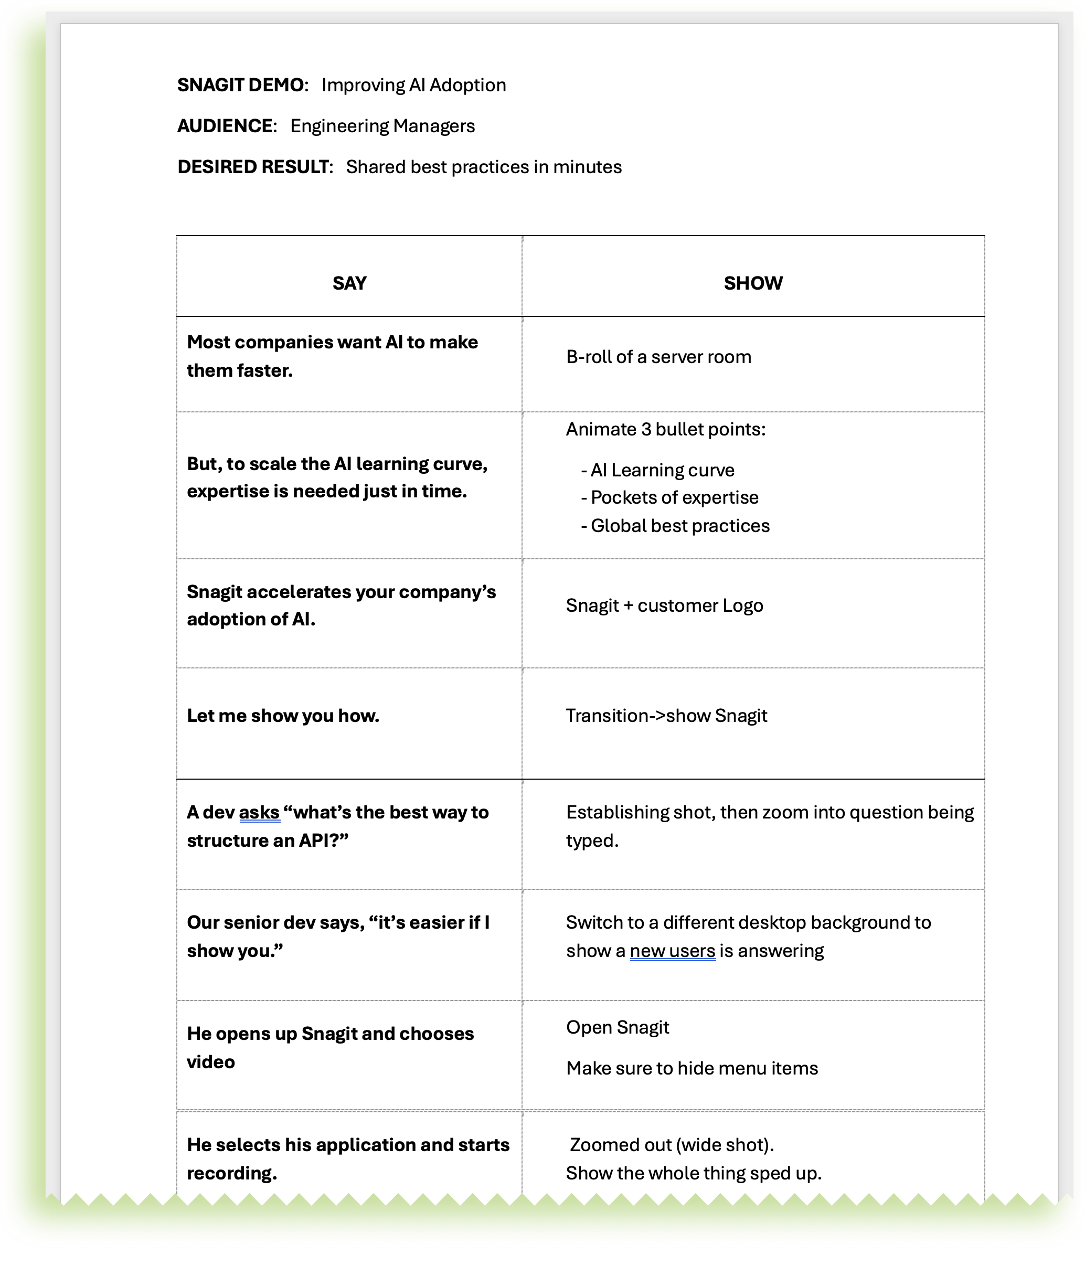
STORYBOARD
Plan it!
Chunk it!
Intro: What’s the problem?
Scenario: When? For whom?
Action: Show problem & solution
Outro: Promised outcomes
Tighten it!
(10 words/scene)
Intro
Scenario
Action

Slide 6
TACTICS FOR DEMO VIDEOS
CUTS
Every 2-5 seconds
Clip speed
“SHOTS”
Wide & close-ups
Angled views
Follow the cursor
ZOOM
Fast (.33 sec)
Scale up to 200+%
CURSOR
Scale to 400+%
Smooth, consistent
VISUAL EFFECTS
Click (Emphasis FX)
AUDIO EFFECTS
Music

Slide 7













BUILDING VIDEOS FOR MORE AUDIENCES
QPA
x100

